Slide 1
Mobile Price Classification:
SVM, Random Forest, and Neural Network
Mohammad Nassar 201911349
Ahmad Ghannam 201910686
Mohammad Jomaa 201911594

Slide 2

IntroDuction
In today's market, price is a critical component in product marketing.
Setting the right price is crucial
We will use SVM,ANN and Random Forest to create a model to help in this.

Slide 3

Introduction…
Many features affect the mobile price like:
RAM
battery capacity
camera quality
display size
Internal memory
display density

Slide 4

Technical Requirements
We used python with scikit-learn library
we evaluate performance using accuracy, precision, recall, and F1 score.
We used google colab PAAS

Slide 5

The Chosen dataset
Contains 2000 examples of mobile phones
The number of attributes is 20
The output is with four ranges 0,1,2,3
Low, medium, high,and very high

Slide 6
Attribute | Description | Datatype
battery_power | battery capacity in milliampere-hours (mAh) | decimal
blue | is Bluetooth available? | boolean
clock_speed | The CPU clock speed in Ghz | float
dual_sim | is the dual sim? | boolean
fc | the front camera in megapixels | decimal
four_g | is the fourth generation of networks supported? | boolean
int_memory | internal memory size in GB | decimal
m_dep | mobile depth in cm | float
three_g | is the third generation of networks supported? | boolean
touch_screen | Does it have a touch screen? | boolean
wifi | Does it have wifi? | boolean

Slide 7
mobile_wt | mobile weight in gram | decimal
n_cores | number of CPU cores | decimal
pc | primary camera in megapixels | decimal
px_height | the vertical resolution of the phone's display screen. | decimal
px_width | horizontal resolution of the phone's display screen. | decimal
ram | Temporary memory size in GB | decimal
sc_h | height of the phone's display in cm | decimal
sc_w | width of the phone's display in cm | decimal
talk_time | battery life of the phone during continuous voice calls over hours | decimal

Slide 8
Data Preprocessing
To create a good-performing model we need to depend on good data
If the dataset have some missing fields or outliers, this will lead to bad training and bad prediction from the model.

Slide 9
Remove Invalid Values
We found some values of screen width is zero,
So we deleted it using python

Slide 10
Data Splitting
The total dataset is splitted to two parts:
80% of the data is training part
20% of the data is validation

Slide 11
Standardization
Provides various benefits such as
better convergence
improved model performance
enhanced interpretability
helps machine learning algorithms make more reliable

Slide 12

Training Algorithms
Supervised Learning
Unsupervised Learning
Reinforcement Learning

Slide 13
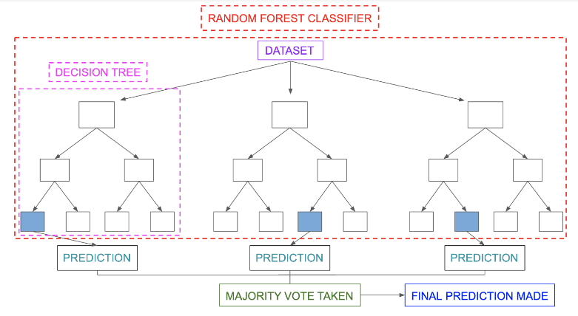
Random Forest

Slide 14
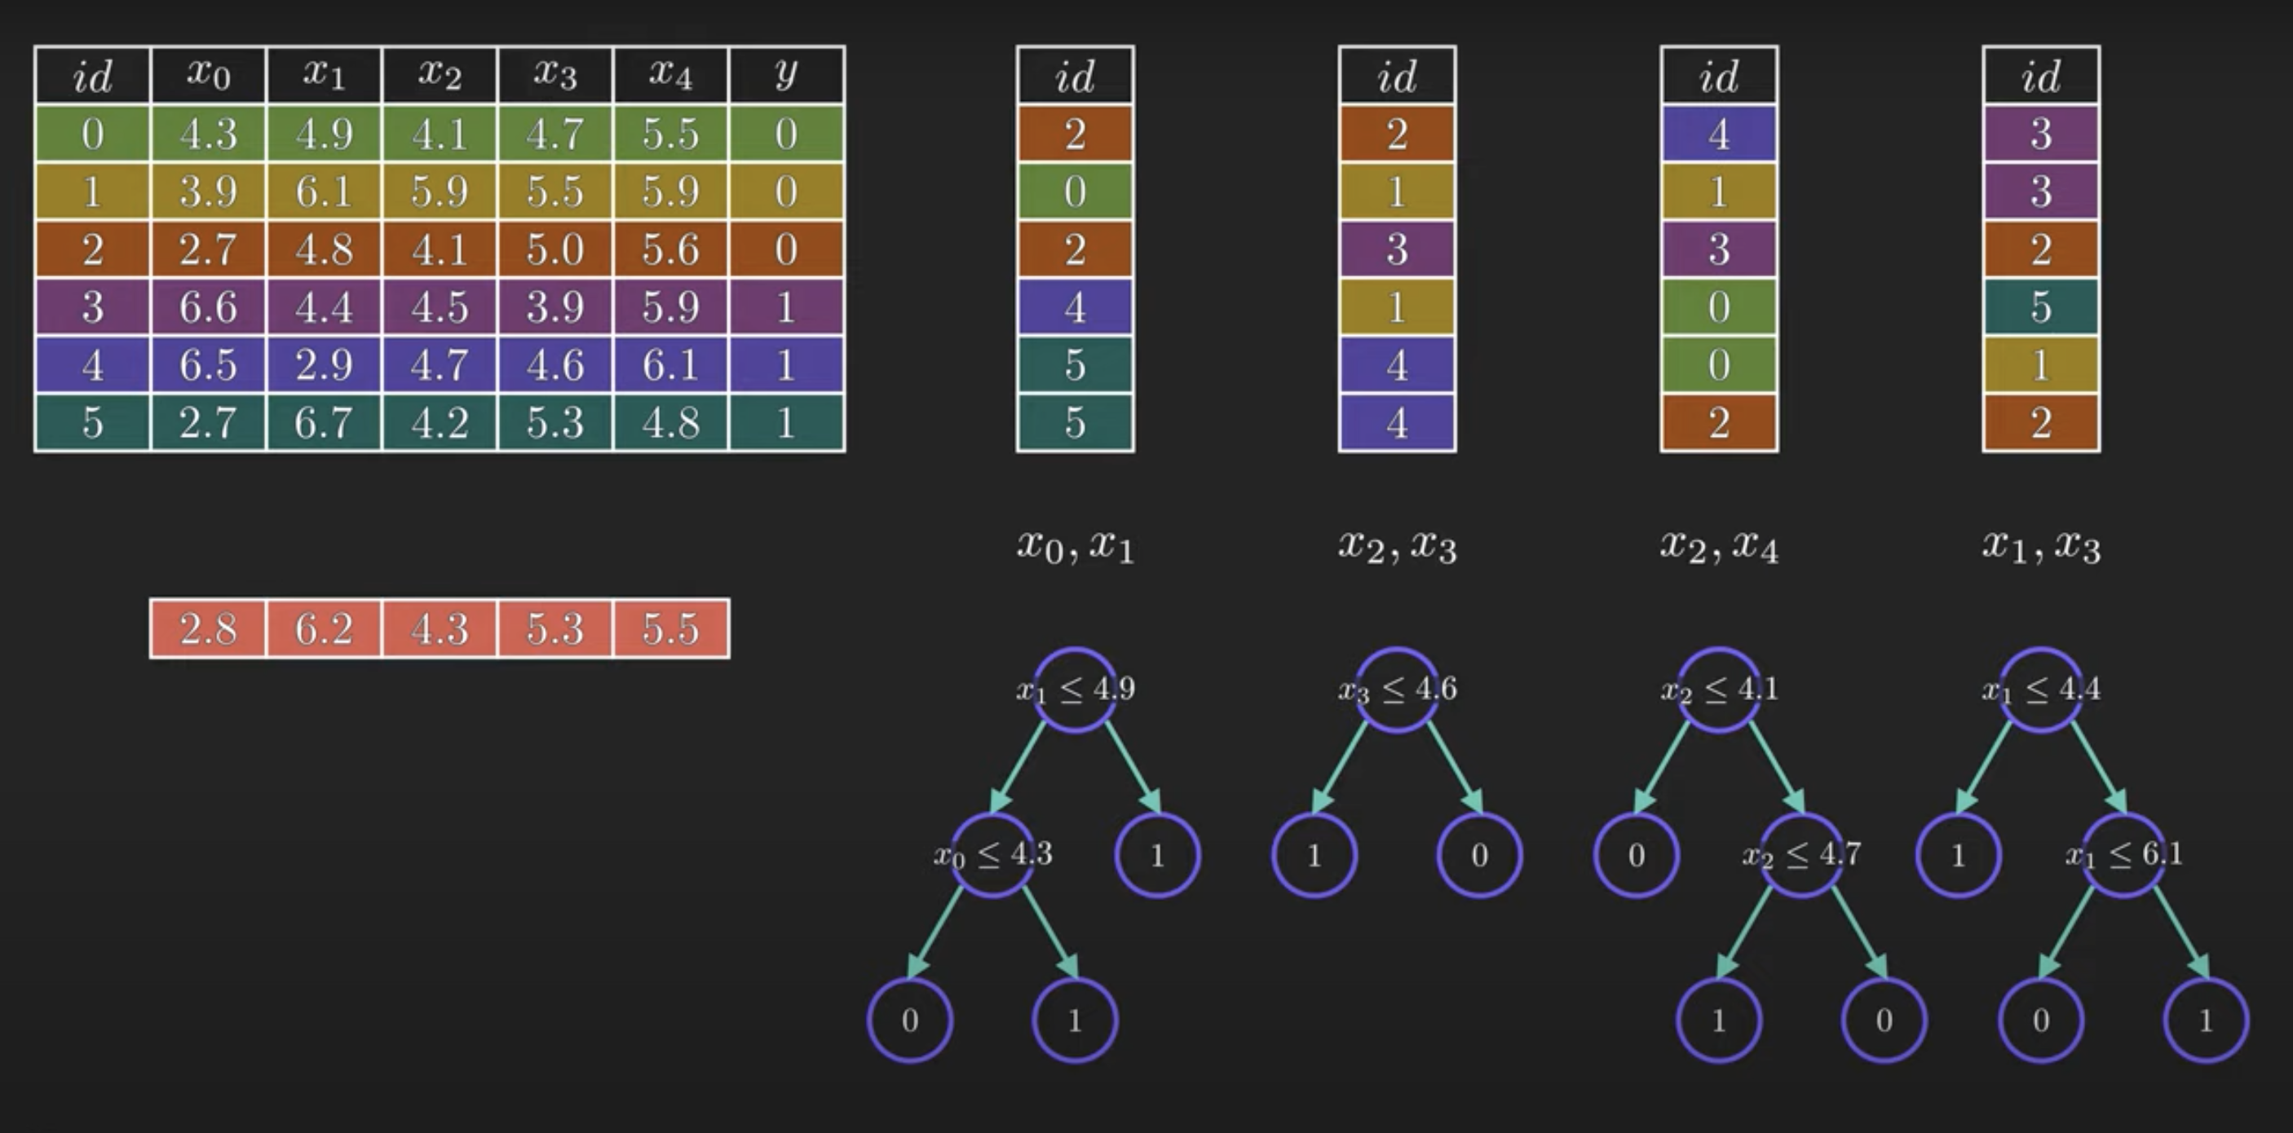
X0 X1 X2 X3 X4
0
1
1
1

Slide 15
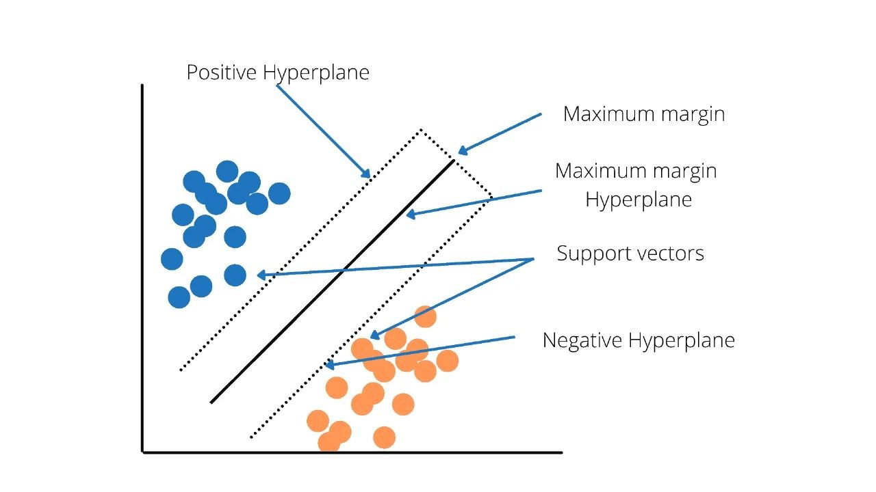
Support Vector Machine (SVM)

Slide 16
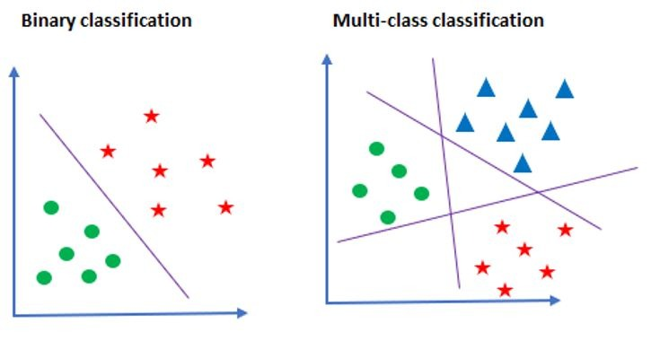
Support Vector Machine (SVM)

Slide 17
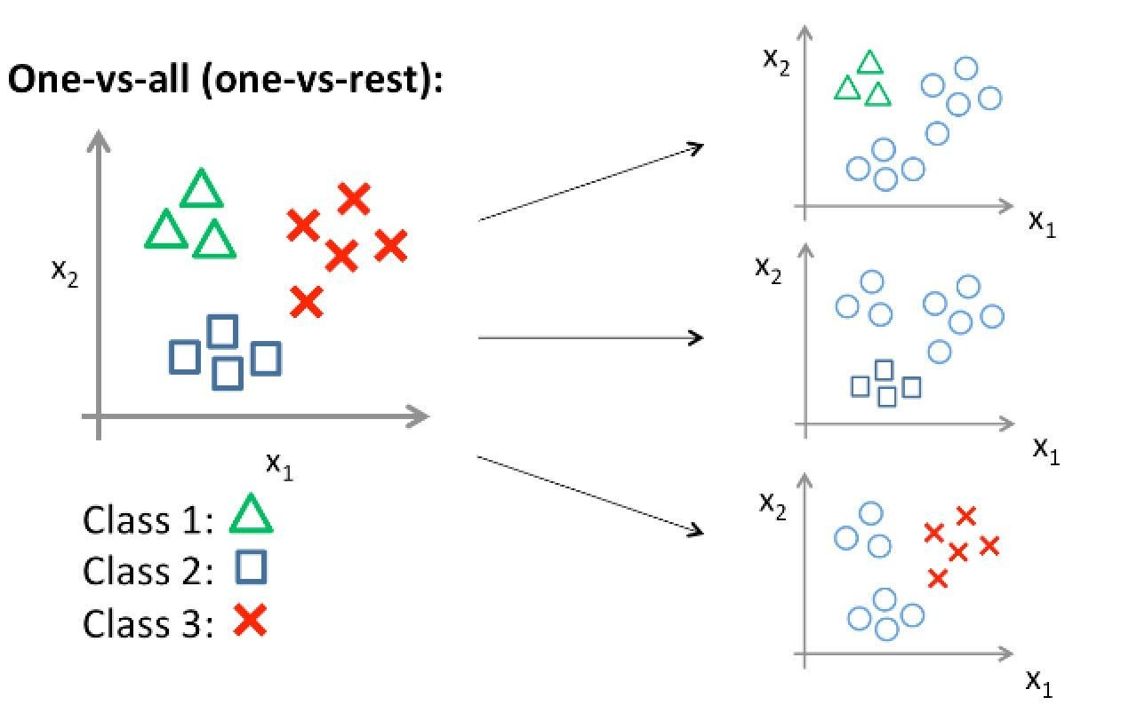
Support Vector Machine (SVM)

Slide 18
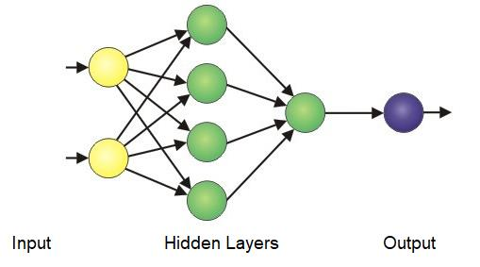
Artificial Neural Networks (ANN)

Slide 19
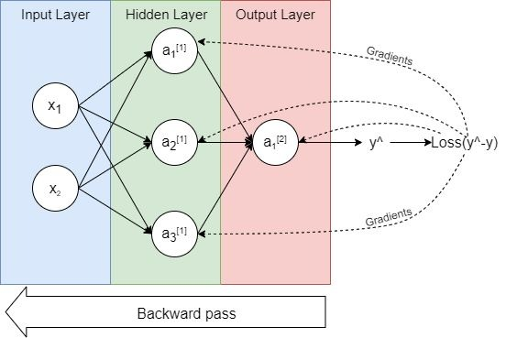

Slide 20
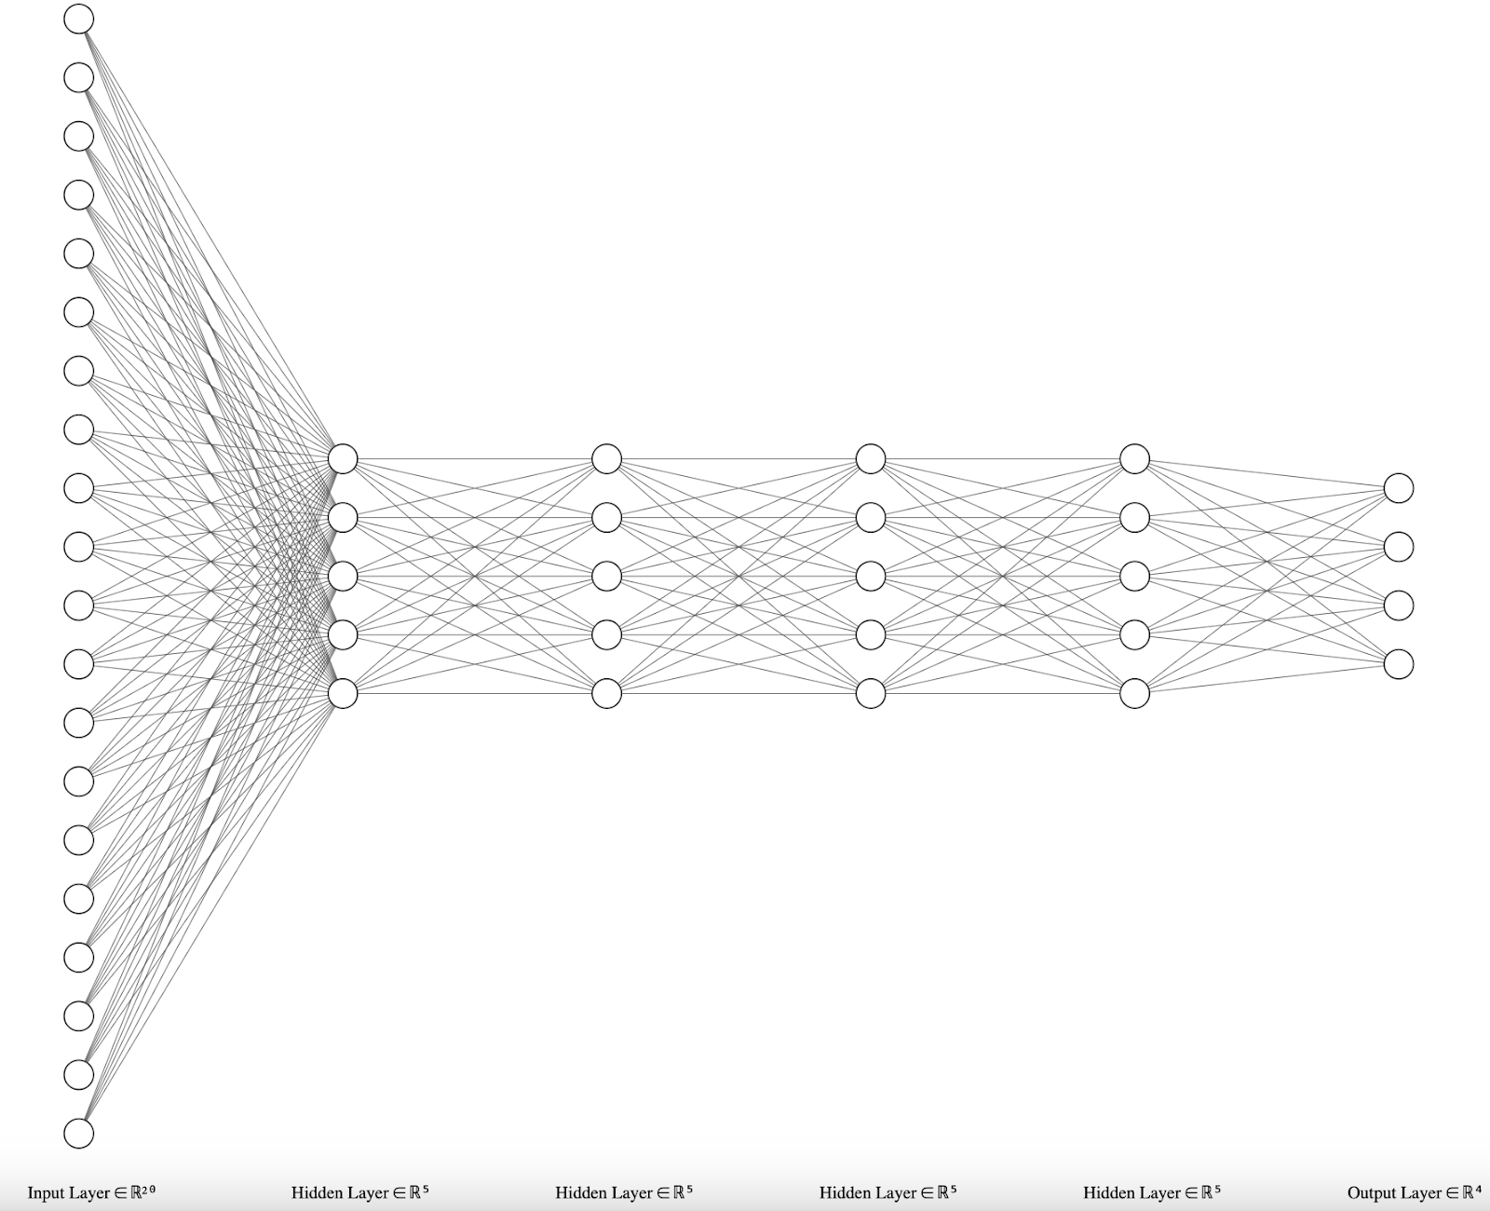
Artificial Neural Networks (ANN) ….

Slide 21
Conclusion
Machine learning may be so helpful and easy to use in some scenarios
but it may be not essential in other cases.
20% to 80% ratio was better than 30% to 70%

Slide 22
Conclusion …
RF achieved an accuracy of 91.25%.
SVM achieved an accuracy of 96.25%.
ANN achieved the highest accuracy of 97% on the validation set.

Slide 23

Thank You Do You Have Any Questions ?

